Slide 1
Quick Notes
Elastic Wave Simulation

Slide 2
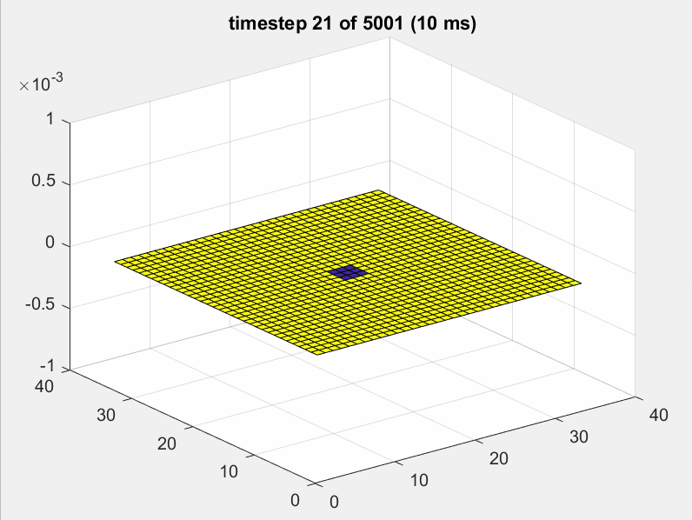
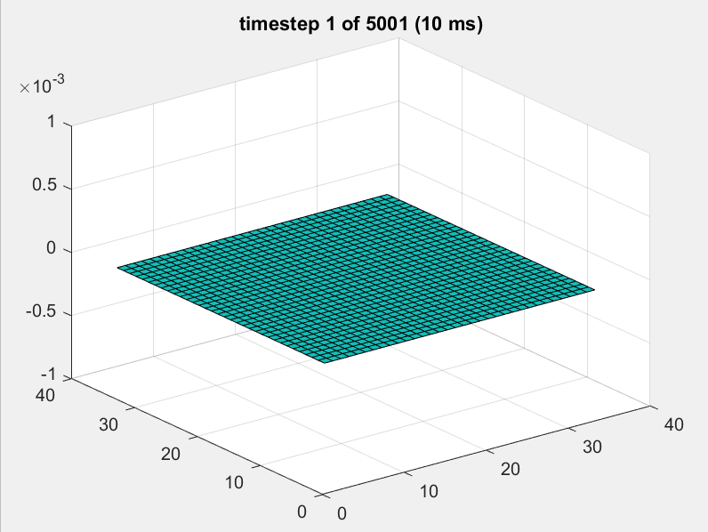
With Dirichlet vs without Dirichlet

Slide 3
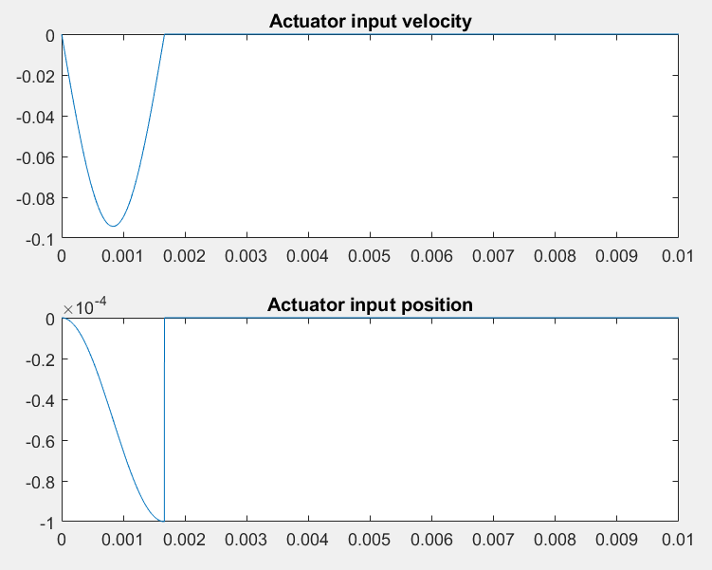
Input

Slide 4
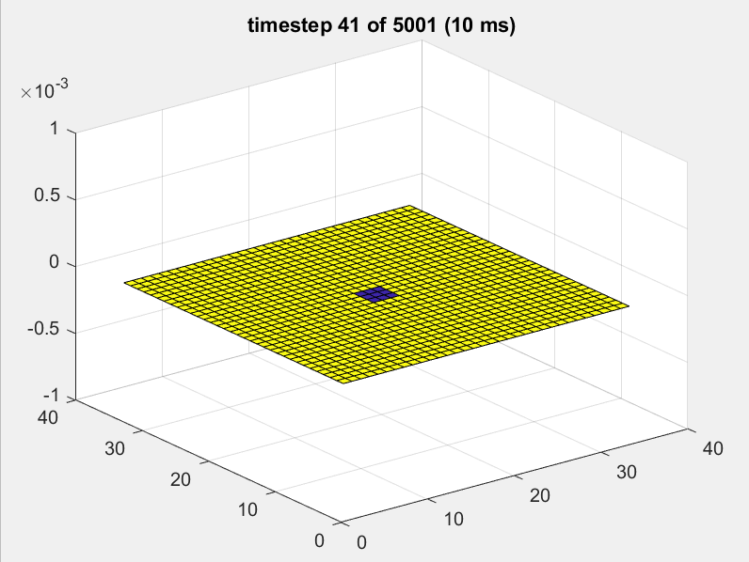
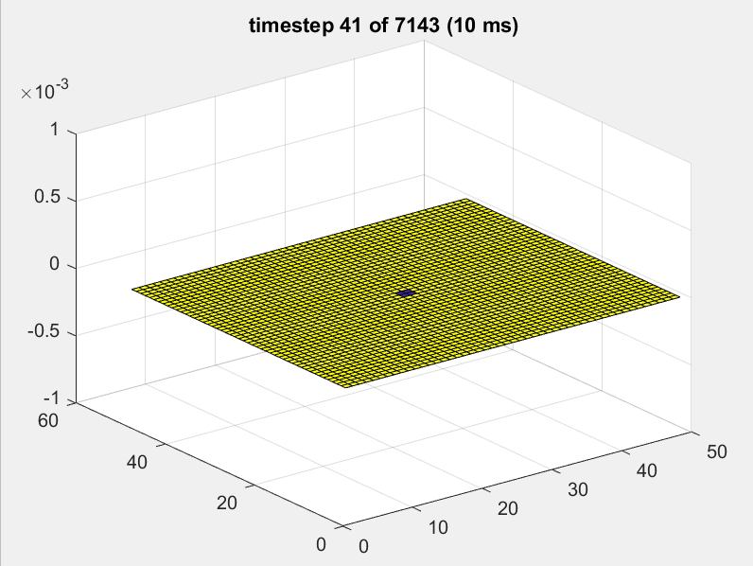
Without Dirichlet, impulse 0.0001m

